Slide 1

Evolutionary Strategy for Embedded Systems:
Knapsack Optimization via Co-Design
Presented by: Ali Akbar Mohsennajad
Supervised by: Dr. Hoda Roudaki

Slide 2
Problem Definition: Fractional Knapsack Optimization
We aim to solve the Fractional Knapsack Problem using an intelligent optimization algorithm, a classic combinatorial optimization challenge.
Objective: Maximize the total value of items selected.
Constraint: Total weight must not exceed the knapsack capacity.
Key Feature: Items can be selected partially, allowing for fractional quantities.
This fractional approach enables a continuous optimization space, distinct from binary (0/1) knapsack problems, making it suitable for certain types of algorithms.

Slide 3



Why Evolutionary Strategy for Knapsack Optimization?
Evolutionary Strategies (ES) offer a robust framework for solving complex optimization problems, particularly those with continuous or fractional characteristics.
Biological Inspiration
Continuous Problem Suitability
Global Search Capability
ES simulates natural evolution: selection of the fittest, genetic recombination, and mutation for diverse solutions.
Robust against entrapment in local optima, ensuring a higher probability of finding globally optimal or near-optimal solutions.
Well-suited for fractional problems where solution variables are continuous, offering fine-grained control over item selection.

Slide 4
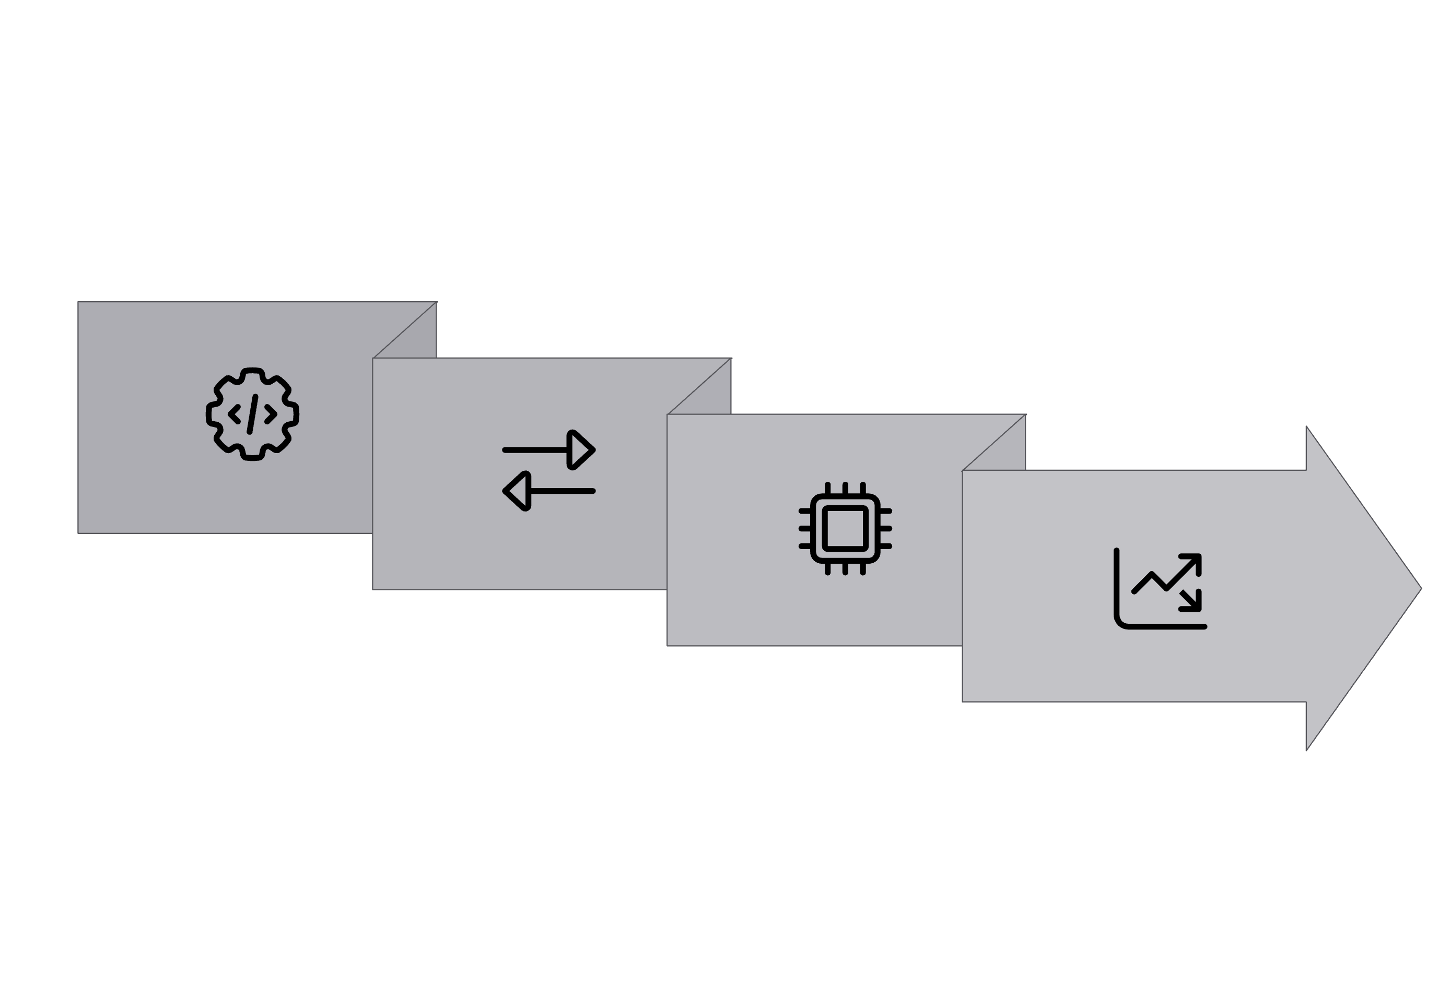

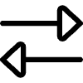


System Architecture: Hardware-Software Co-Design
Our solution employs a co-design approach, distributing computational load between software and hardware components for enhanced performance and flexibility.
Data Exchange
Evaluation
MATLAB Control
SystemC Computation
Software (MATLAB): Manages algorithm control, fitness evaluation, and population selection.
Hardware (SystemC): Accelerates computationally intensive operations like recombination and mutation.
Data Exchange: Achieved efficiently via .dat files, ensuring seamless communication between the two platforms.

Slide 5
Evolutionary Strategy Algorithm Flow
The co-designed ES algorithm follows a cyclical process, iteratively refining solutions towards optimality.
Initialize Population: Create an initial set of random solutions.
Evaluate Fitness: Assess the quality of each solution based on the objective function.
Select Parents: Choose individuals for reproduction based on their fitness scores.
Crossover & Mutation: Generate new solutions (offspring) using genetic operators (performed in SystemC).
Evaluate Children: Determine the fitness of the newly generated offspring.
Select Best: Form the next generation by selecting the most promising individuals.
Stop Condition: Terminate the process when a satisfactory solution is found or no significant improvement is observed.

Slide 6

MATLAB Implementation: The Control Hub
MATLAB serves as the orchestrator of the evolutionary process, handling critical tasks that maintain algorithm flow and decision-making.
Initial Population Generation: Randomly creates the first set of candidate solutions.
Fitness Calculation: Computes the objective value for each solution, applying penalties for overweight scenarios.
Chromosome Transfer: Transmits current generation's "genes" to the SystemC module for hardware acceleration.
Offspring Reception: Receives the modified and recombined offspring from SystemC.
Evolutionary Loop Control: Manages the iterations, stopping criteria, and overall progression of the algorithm.

Slide 7

SystemC Implementation: Hardware Acceleration
SystemC, a C++ library for system-level design, is instrumental in offloading and accelerating the computationally intensive genetic operations.
Recombination Module: Implements crossover strategies to combine genetic material from parents.
Mutation Module: Introduces random variations using both Gaussian and Uniform mutation schemes for diversity.
Parallel Processing: Leverage hardware description capabilities to perform operations in parallel, significantly reducing execution time.
Output Generation: Provides the modified genes (offspring) back to MATLAB for subsequent fitness evaluation.

Slide 8
Results & Performance Comparison
Our co-design approach demonstrates a significant improvement in solution quality while maintaining efficiency, even with increased communication overhead.
Best Fitness
22.54
24.13
Execution Time
0.01 sec
4.18 sec
Capacity Used
99.6%
100%
Effective Items
3
4
The co-design approach allows for a more thorough exploration of the solution space, leading to a higher quality solution, reflected in the 'Best Fitness' and 'Effective Items' metrics, despite the communication overhead.

Slide 9





Conclusion & Future Directions
This co-design methodology offers a powerful paradigm for optimizing complex problems in embedded systems.
Enhanced Quality
Optimized Performance
Co-design significantly improves result quality through hardware acceleration of genetic operations.
MATLAB provides algorithm flexibility, while SystemC enhances performance for critical computational tasks.
Future Work: FPGA
Multi-Objective Problems
Future plans include porting the SystemC implementation to FPGA for even greater hardware acceleration.
Adapting the framework to solve multi-objective optimization problems in embedded contexts.

